Slide 1
Unused Land Renting System

Slide 2
Class Diagram

Slide 3
Activity Diagram

Slide 4
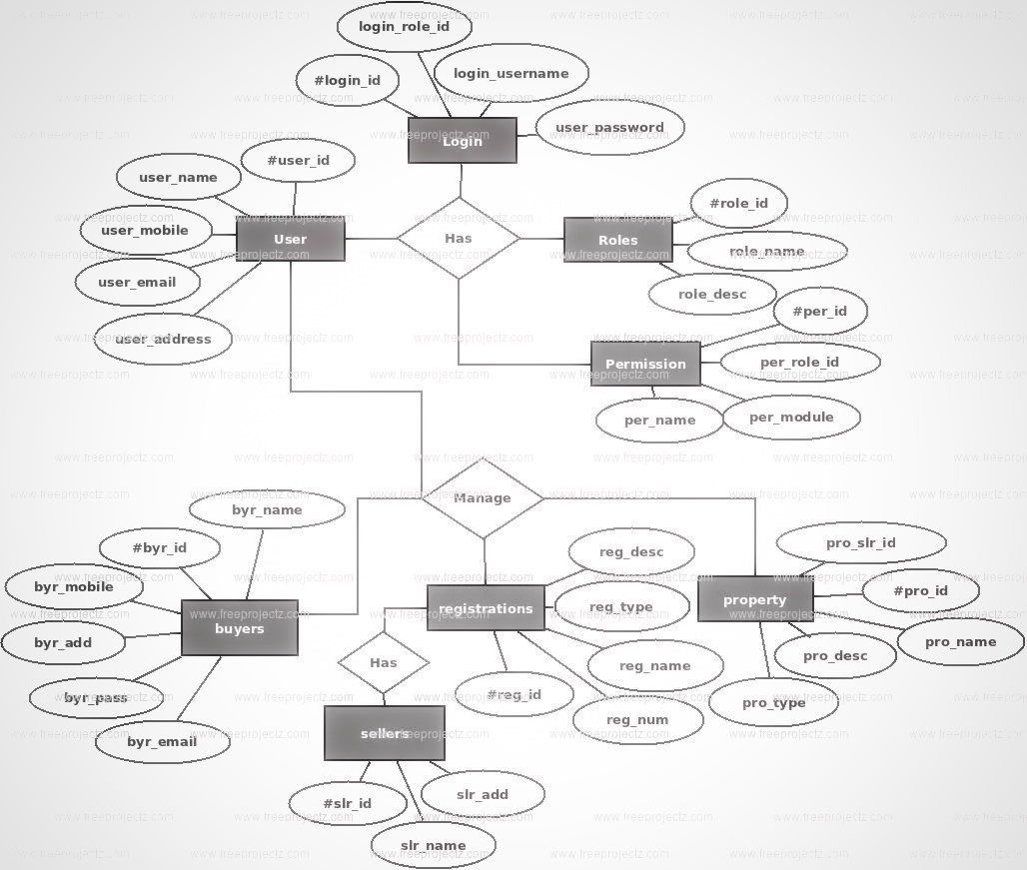
Database Schema

Slide 5
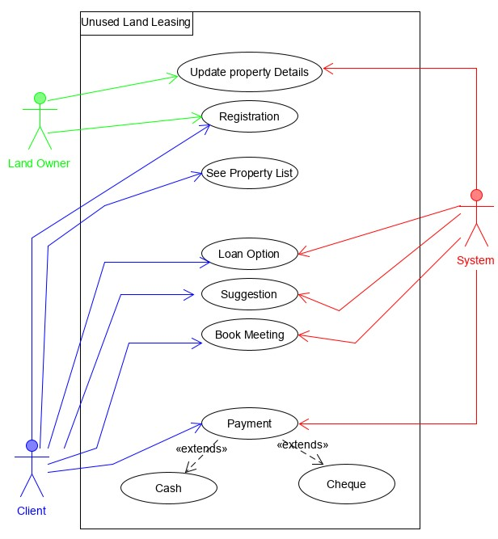
Mockup Design

Slide 6
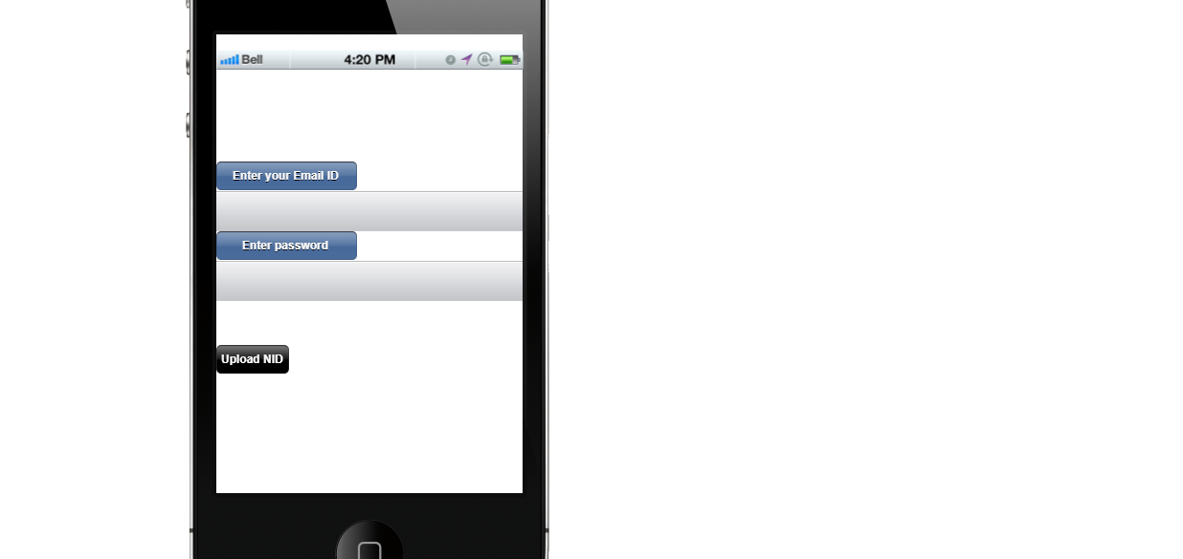
First Page

Slide 7
Second Page

Slide 8
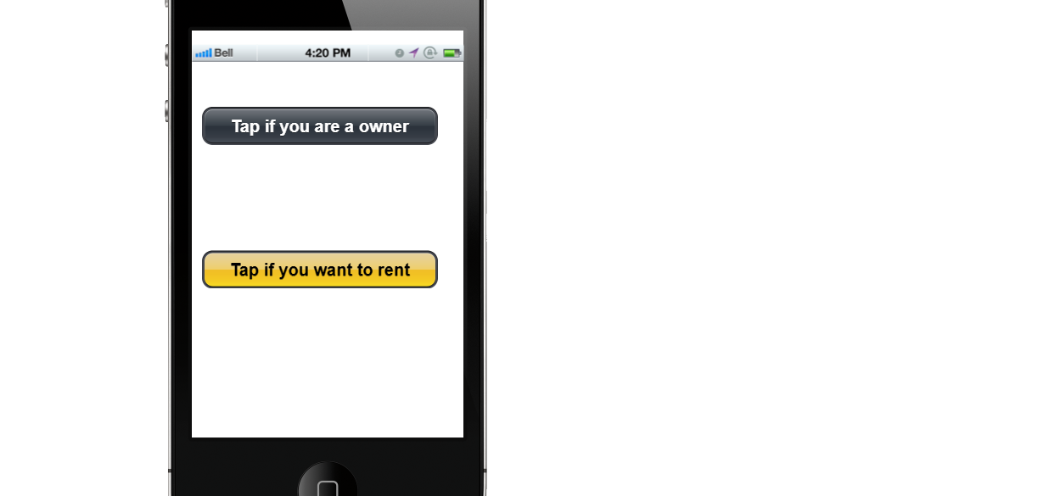
Third Page

Slide 9
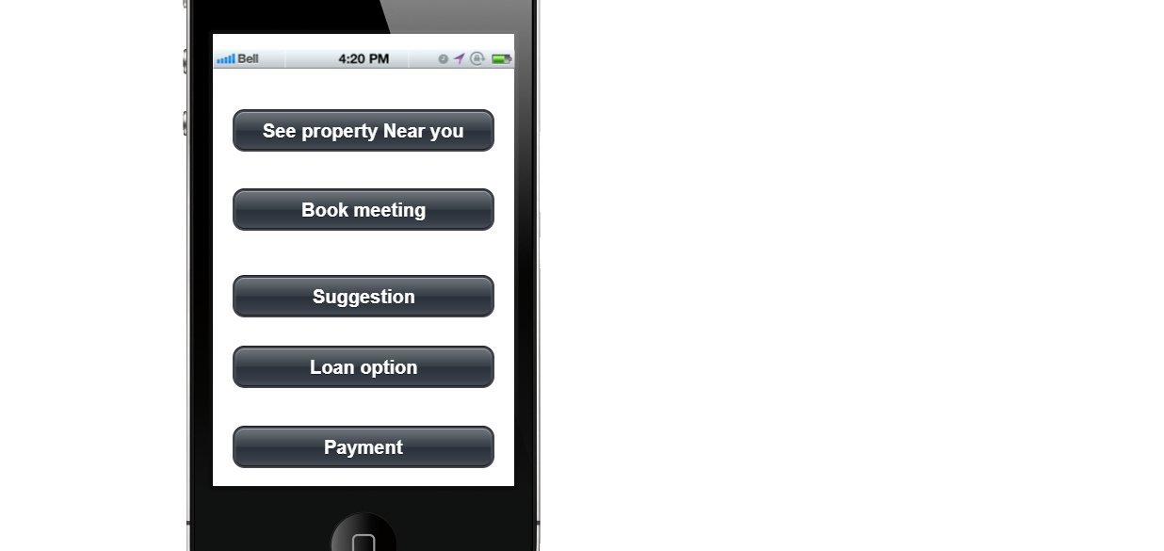
Fourth Page

Slide 10
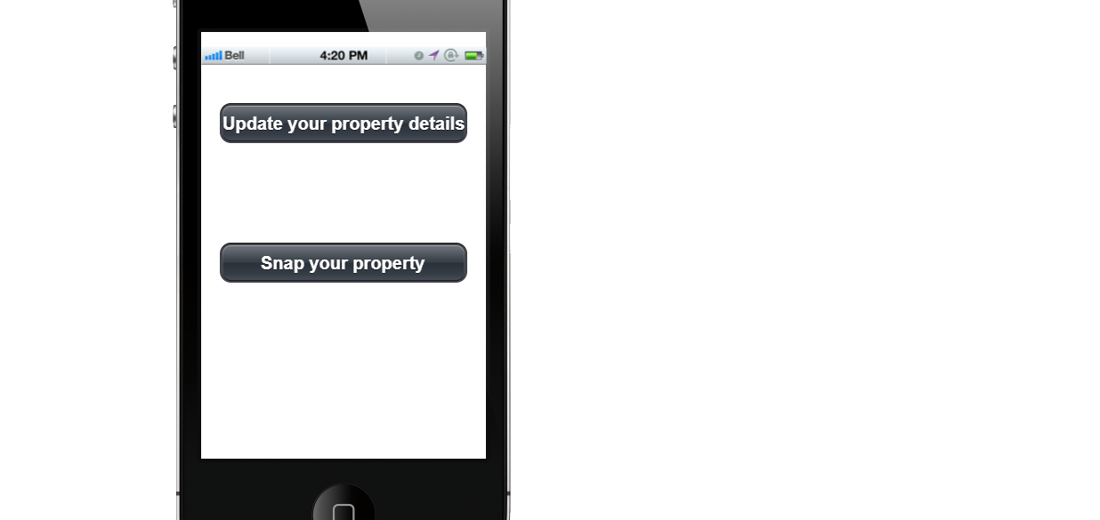
Last Page

